Slide 1

Car Analysis

Slide 2

Strategies
Cars
Costs
Utilization

Slide 3
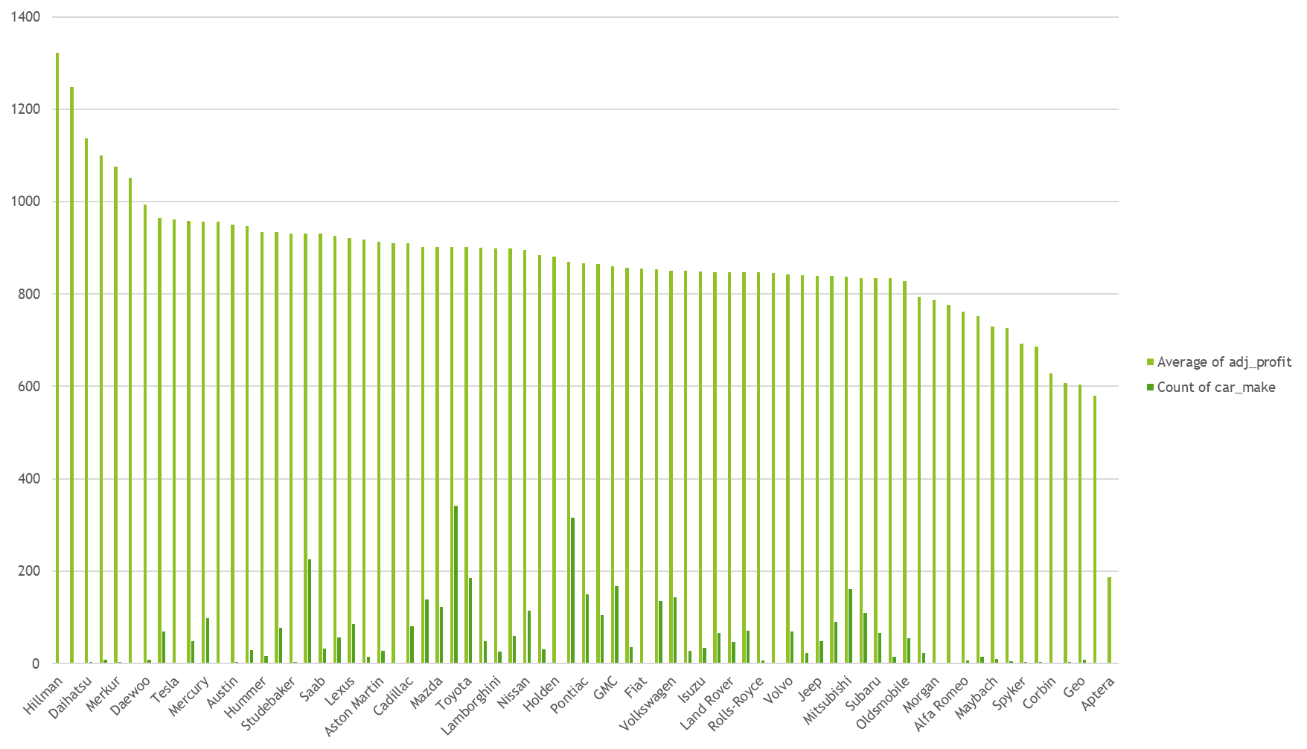
1. Identifying Trend
*note bulk of cars lie in center of data, select for these.
Notes:
Identify high earners
Some perform very poorly

Slide 4
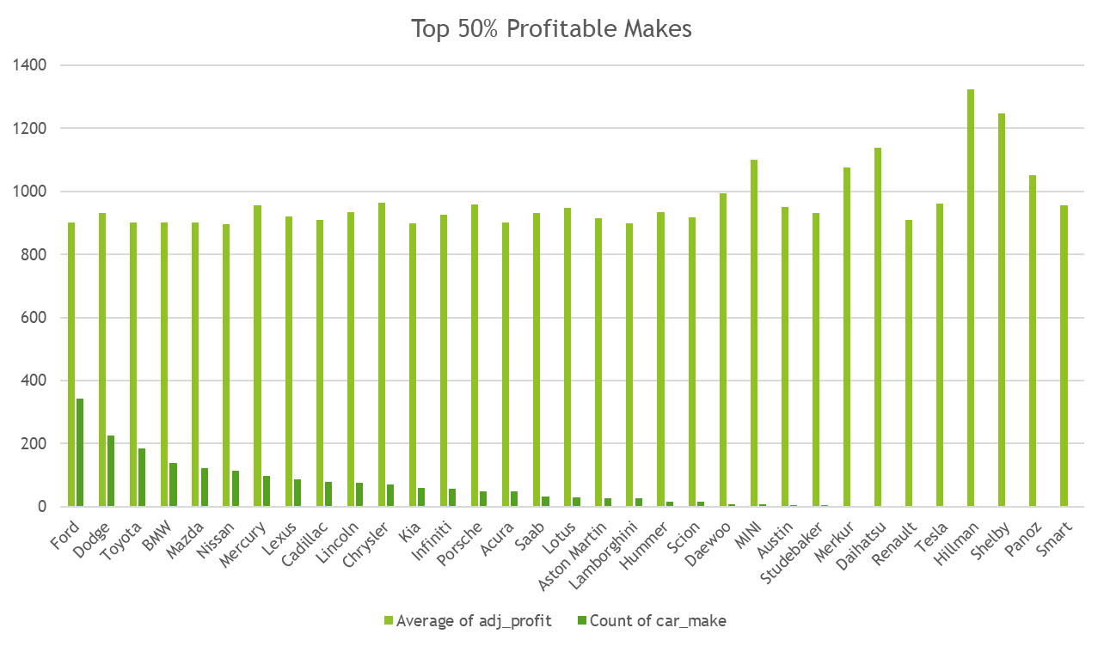
1. Dig Deeper
*identify top earning makes
Notes:
Top 5 Profitable makes make up 1013 of 4000 cars
Avg. Profit – 881.76
Top 5 Average - $908

Slide 5
1. Breakdown: Cars – Top 50% vs. Baseline
Profit per Car
Top 50%
$969.13
Baseline
$881.77
Bottom 50%
$788.01
Results
Ford
Dodge
Toyota
BMW
Mazda
Average Profit:
$907
Difference:
$26 per car over average
Notes:
26$ increase over 4000 cars per month is 1.25million in increased profits.

Slide 6
1. Identify Top 5 of Each Make
*identify similar trend within makes as all the makes have, select for high earners
Notes:
Top 5 Performers
Dodge: $1,262
BMW: $1,198
Mazda: $1,170
Ford: $1,237
Toyota: $1,196
25 cars → 40 of each
Further extending increased profits. ~$1200 per month
Additional 1000 cars at this approximate monthly profit → generates $14.4 million annually

Slide 7
Strategies
Cars
Costs
Utilization

Slide 8
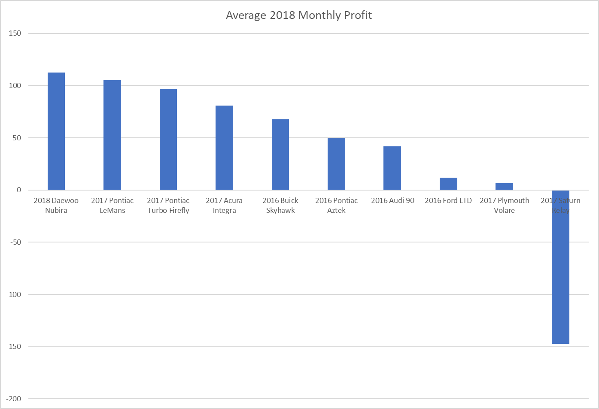
2. Cost – Bottom Performing Cars
*only 1 car not profitabl
Notes:
Briefly touch on. Some cars just aren’t performing at high enough level
Could Isolate and Replace…

Slide 9
Strategies
Cars
Costs
Utilization

Slide 10
Usage -Insight
Average Rental Price ~$162
*frequency consistent with $162 average per night, drive higher rental lengths.
Notes:
Frequency same
Majority of rental from long rentals
Price same per day - $162

Slide 11
Marketing – Discounting Rental Cost
10% of Daily Cost Reduction on Rentals of 7+ Days
Marketing Cost = $(1,611,054.90)
Amount of Increased Usage???
Only 3% increase of usage = $650,993.31
Notes:
Small increase in usage → can cover small changes in cost per day

Slide 12
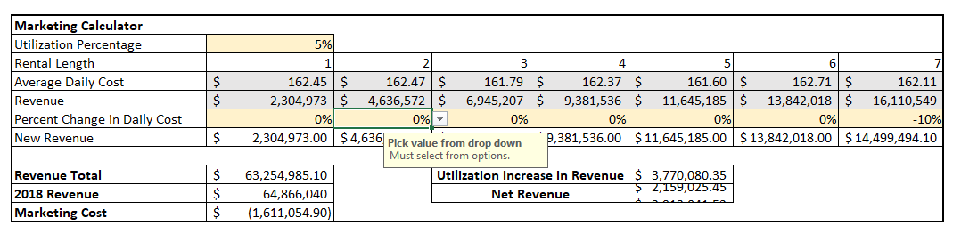
Usage ROI
*calculator can give a better understanding how cost and ROI of altering prices.
Notes:
Cost offset by raising prices at low rental legnths and cost up by reducing price per day at higher lengths.
Example Calculator
20% increase in usage
27% usage this year → 33% usage
$ 15,080,321.40 revenue generated → 35.6% increase in revenue

Slide 13

Results:
ADD:
Ford
Dodge
Toyota
BMW
Mazda
Remove:
2017 Saturn Relay
Several other cars performing far below average.
Focus: Increased Utilization

Slide 14
Questions?

